Slide 1
MC’s highlight
…
Notes:
So, I did promise you my pick from Build. Roll video!

Slide 2
MC’s HIGHLIGHT
Roll the video!
Notes:
Demo video: 05-01 – Project Volterra.mp4

Slide 3
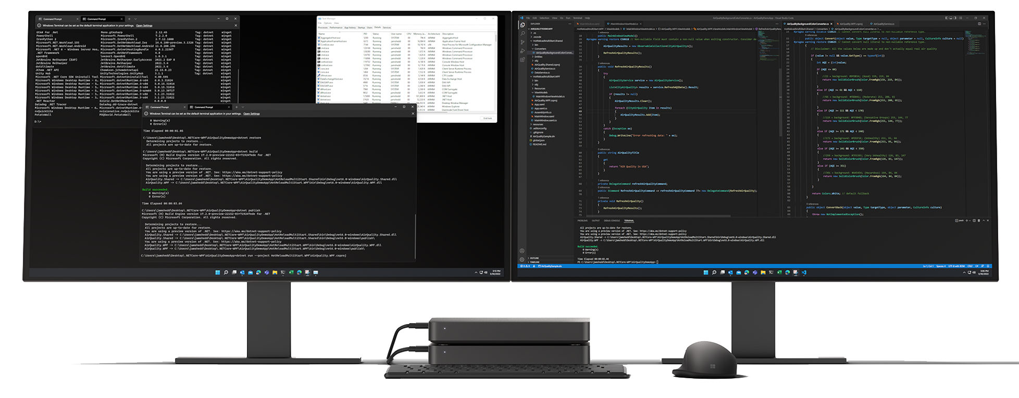
Project Volterra
Project Volterra
Notes:
What's not to love about new hardware? Especially a device case that's made with 100% reclaimed ocean plastics and can be stacked or rack mounted.
Project Volterra is powered by the Snapdragon compute platform, enabling developers to explore AI scenarios via the new Qualcomm Technologies' Neural Processing SDK for Windows.
And as NPUs become more common, we're baking support for them into the end-to-end Windows platform.
We're are also announcing a comprehensive end-to-end ARM-native toolchain for RM native apps, including:
Full Visual Studio 2022 & VS Code
Visual C++
Modern .NET 6 and Java
Classic .NET Framework
Windows Terminal
Windows Subsystem for Linux and Windows Subsystem for Android
No release date yet so watch this space.
https://blogs.windows.com/windowsdeveloper/2022/05/24/create-next-generation-experiences-at-scale-with-windows/

Slide 4
What next?
Azure OpenAI Service Private preview application https://aka.ms/oaiapply
Build 2022 useful links
Watch all the videos
https://aka.ms/build2022
Read the Book of News
https://aka.ms/build-2022-book-of-news
All links from this event https://aka.ms/Build2022ANZDevs
Notes:
And to bring today's event to a close for our online viewers, here are some resources to go and check out.
If you are interested in access to the Azure OpenAI Service, you can apply for the private preview at aka.ms forewardslash oaiapply
Or dive into more from Build including the session videos at aka.ms forewardslash build2022, with a summary of all the announcements in the Book of News.
Thank-you for joining us for this Microsoft Build recap and good luck building what the world needs!

